Slide 1
Movie Recommendation System using k-Nearest Neighbors
COURSE: MIS-637
PROFESSOR: Dr. M. Daneshmand
AUTHOR: Manish Narwal
CWID: 10446525

Slide 2
PROBLEM STATEMENT
Recommendation system are used to recommend items to users based on their past history of use.
For e.g: If I have bought a phone from an online store, then a good recommendation system will show me things people have bought along with the phone (like headphones, phone case etc.)
A good recommendation system will bring profits for the company. Especially a movie recommendation system that can provide recommend good movies based on your search.
Hence, people are always more attracted to good recommendation system as it keeps the consumer engaged with the service provider.

Slide 3
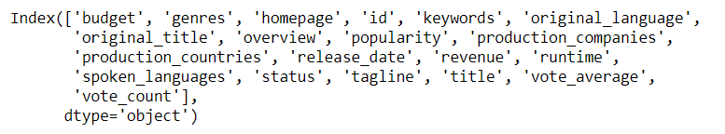
DATASET
The data was from themoviedb.org.
There are 2 CSV files:
tmdb_5000_movies.csv: The following are its variables
tmdb_5000_credits.csv: The following are its variables

Slide 4
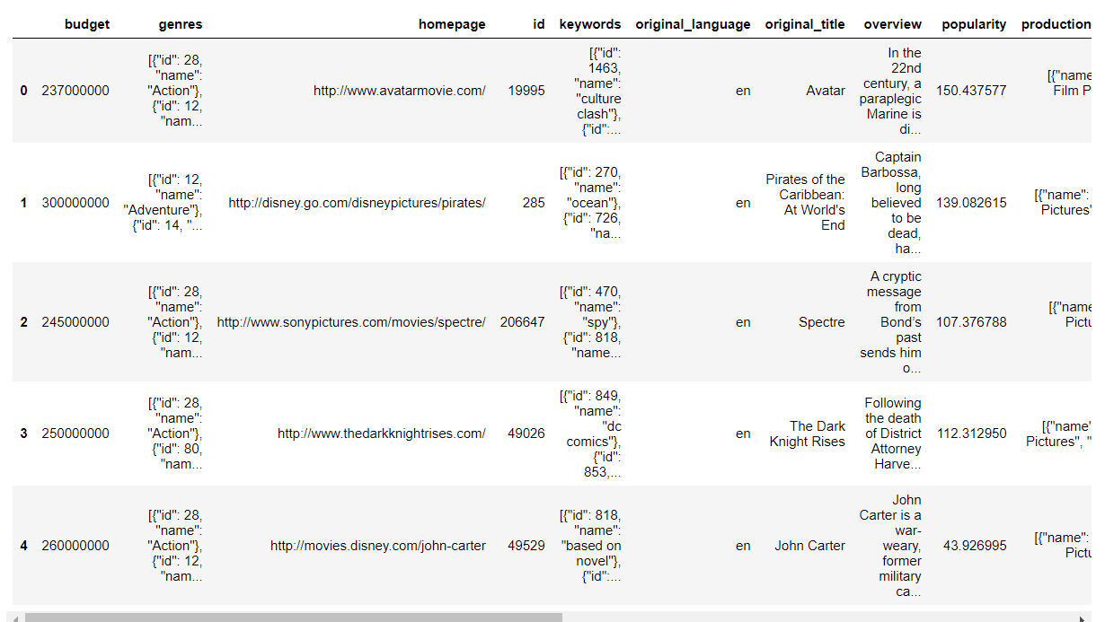
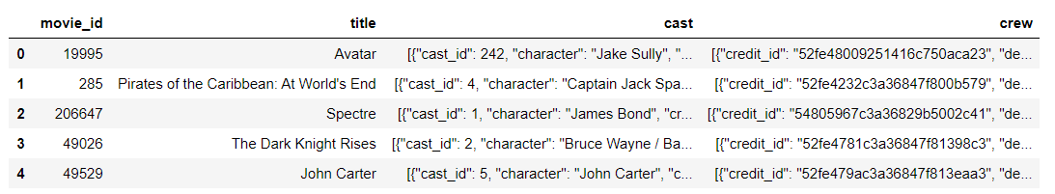
DATA PREVIEW AND SOFTWARE USED
PREVIEW OF BOTH CSV FILES (Left image=movies and right image= credits)
SOFTWARE: I used Python for this project.

Slide 5
DATA CLEANING AND PREPARATION
As it can be observed from the previous slide images that some variables are not in our required format.
Variables like ‘genres’ and ‘cast’ are in dict of list form(in Python language: dictionary in a list) hence there was a need to clean it to extract only meaningful values.
And after extracting these values (which will be in categorical form) I converted it into numerical form by the means of One-Hot encoding in which a binary variable is assigned for each unique value.
Also, number of irrelevant variables(columns) like ‘homepage’, ‘original_language’, ‘budget’ etc. was dropped as they can be unnecessary hurdle and I am not going to use them anyway.
All the duplicate movie titles was dropped.

Slide 6
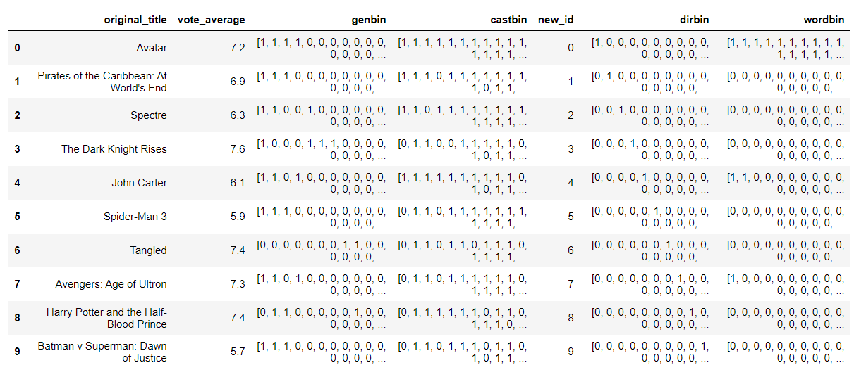
PREPARED DATA
This is what I got after cleaning

Slide 7
ALGORITHM
k-Nearest Neighbors algorithm was used to get good movie recommendations.
Steps
Load Dataset
Data Cleaning
Bring data to desired format
Finding Similarity by Cosine similarity (nearest neighbor)
Get recommendations

Slide 8
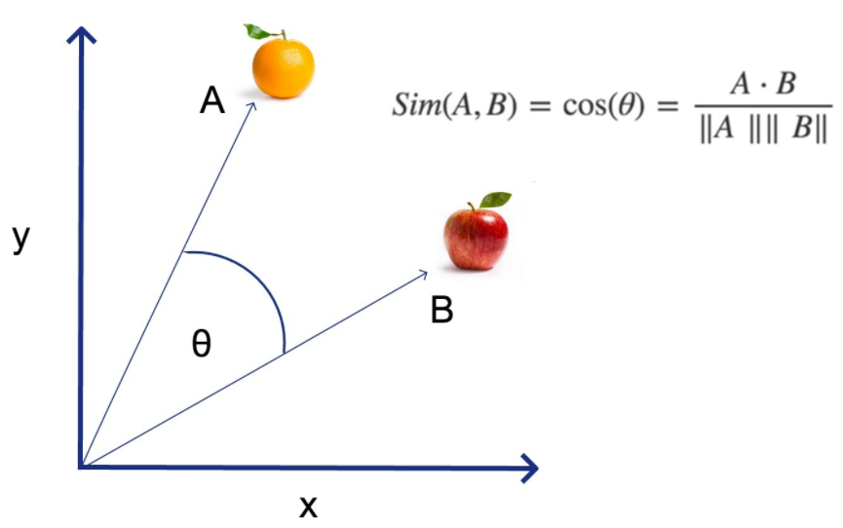
WHY COSINE SIMILARITY ?
Euclidean distances can often be of no use when there is high dimensional dataset like here, so cosine similarity is used in high dimensional dataset to search for nearest neighbor. (Image Source: https://www.linkedin.com/pulse/cosine-similarity-classification-michael-lin/)

Slide 9
IMPORTANT POINTS
I have taken K=10 to get 10 movies recommendations.
For better results I’ll not be using ‘popularity’ variable as there is chance of bias.
For finding nearest neighbor I’ll be considering variables like ‘genre’, ‘director’(from crew column), ‘cast’ and ‘keywords’ as they will be of great help.

Slide 10
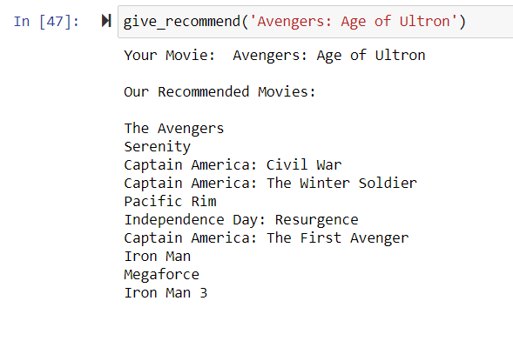
EXECUTION

Slide 11
OBSERVATIONS
Wow! The recommendations works really well.
I entered an Avengers movies to check whether its really showing good recommendations.
It shows relevant movies with varieties like some marvel studios movies, some sci-fi(Pacific Rim, Mega Force etc.) and some drama movies like Serenity.
These variety is very important to maintain interest of the users.

Slide 12
CONCLUSION
The recommendation system works in excellent manner.
The 10 movies recommended are from different timelines(some are 1990’s movies and some are latest ones like 2018-19) so it’s great that it recommends movies from different period of time.
It was easy for me to choose K=10 here in different applications it can get tricky and complicated.
Due to my initial considerations of not including popularity the bias did not happen in this case and hence recommendation were accurate.

Slide 13
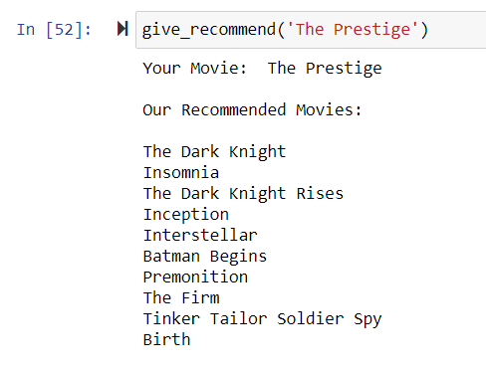
FINAL THOUGHTS
After executing the code again and again, I noticed that recommendation system doesn’t have any major loopholes.
I wouldn’t want to make any further changes in the system because I think it is more accurate and hence reliable.

Slide 14


Slide 15
REFERENCES
Brownlee, Jason. “Why One-Hot Encode Data in Machine Learning?” Machine Learning Mastery, 30 June 2020, machinelearningmastery.com/why-one-hot-encode-data-in-machine-learning/.
Dataset: https://www.kaggle.com/tmdb/tmdb-movie-metadata/download
https://www.itm-conferences.org/articles/itmconf/pdf/2017/04/itmconf_ita2017_04008.pdf
Real Python. “Build a Recommendation Engine With Collaborative Filtering.” Real Python, Real Python, 26 Nov. 2020, realpython.com/build-recommendation-engine-collaborative-filtering/.
AdvisoryLike12Comment0ShareLinkedInFacebookTwitter0, Michael Lin ??FollowAnalytics, and Follow. Cosine Similarity & Classification, www.linkedin.com/pulse/cosine-similarity-classification-michael-lin/.
Sharma, Natasha. “Importance of Distance Metrics in Machine Learning Modelling.” Medium, Towards Data Science, 15 Jan. 2019, towardsdatascience.com/importance-of-distance-metrics-in-machine-learning-modelling-e51395ffe60d.

